Slide 1

Exploring Stock Movements
By Haozhe Zeng & Zixiao Wang

Slide 2
金融行业年终工作总结
LOGO HERE
OfficePLUS
0
单击添加副标题信息
单击添加副标题信息
OfficePLUS
单击添加副标题信息

Slide 3
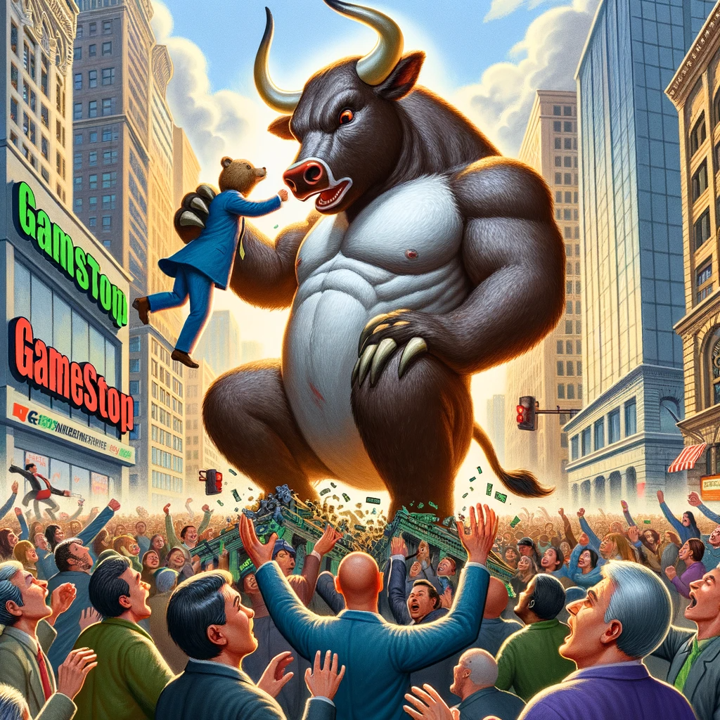
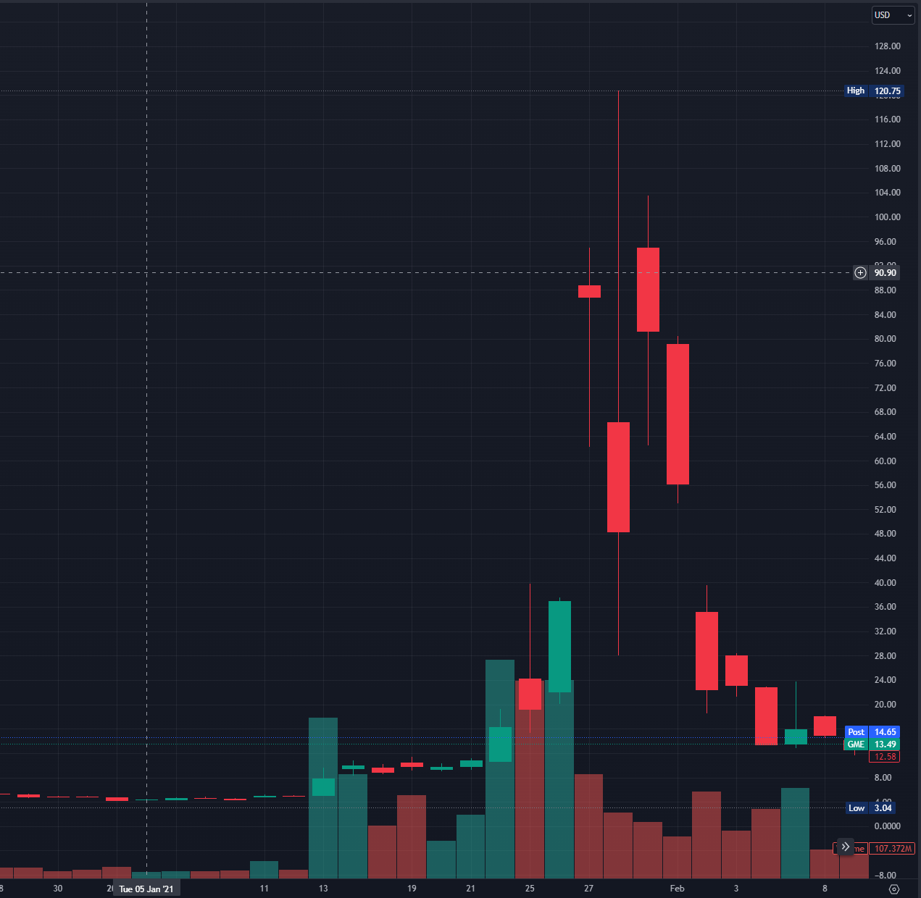
Motivation
GameStop short squeeze

Slide 4
Cleaning, Entity Matching, Merging, etc.
Post from Twitter and Reddit
Sentiment Labeling
Quantify/Normalize Data
Processing, Indicators Calculating, etc.
Stock data: Close, Volume, etc.
Time Series Modeling
Buy/Sell Decision
Return

Slide 5
Problem Definition
Construct a model to capture buying and selling signal of the stock market
Modeling stock market signals for buying and selling
Decision making using the return from models
Implement sentiment analysis of retail trader and study their impact
Entity matching
Sentiment analysis

Slide 6
Why this approach
Similarities:
There are paper study the correlation between stock market and retail traders’ sentiment
There are paper about building models to predict stock return
Uniqueness
We implemented a dynamic approach to make short term prediction
We focus both on loss and gain
We incorporate sentiment analysis into our model

Slide 7
Approach: Sentiment Analysis

Slide 8
What we have for sentiment analysis

Slide 9
Approach: Stock Movement Prediction
Objective:
Window Size Selection
Hyperparameter tunning
Dynamic Decision Making
Make decision based on the distribution of returns of past “Window_size” days
Price Vs. Return
Feature Selection
Stationary vs Nonstationary data
Data used to train the model
Optuna, A hyperparameter optimization framework

Slide 10
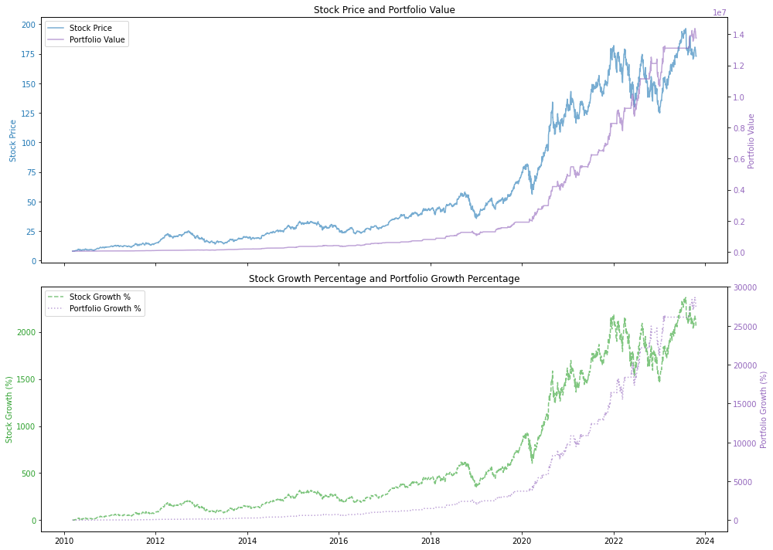
Apple

Slide 11
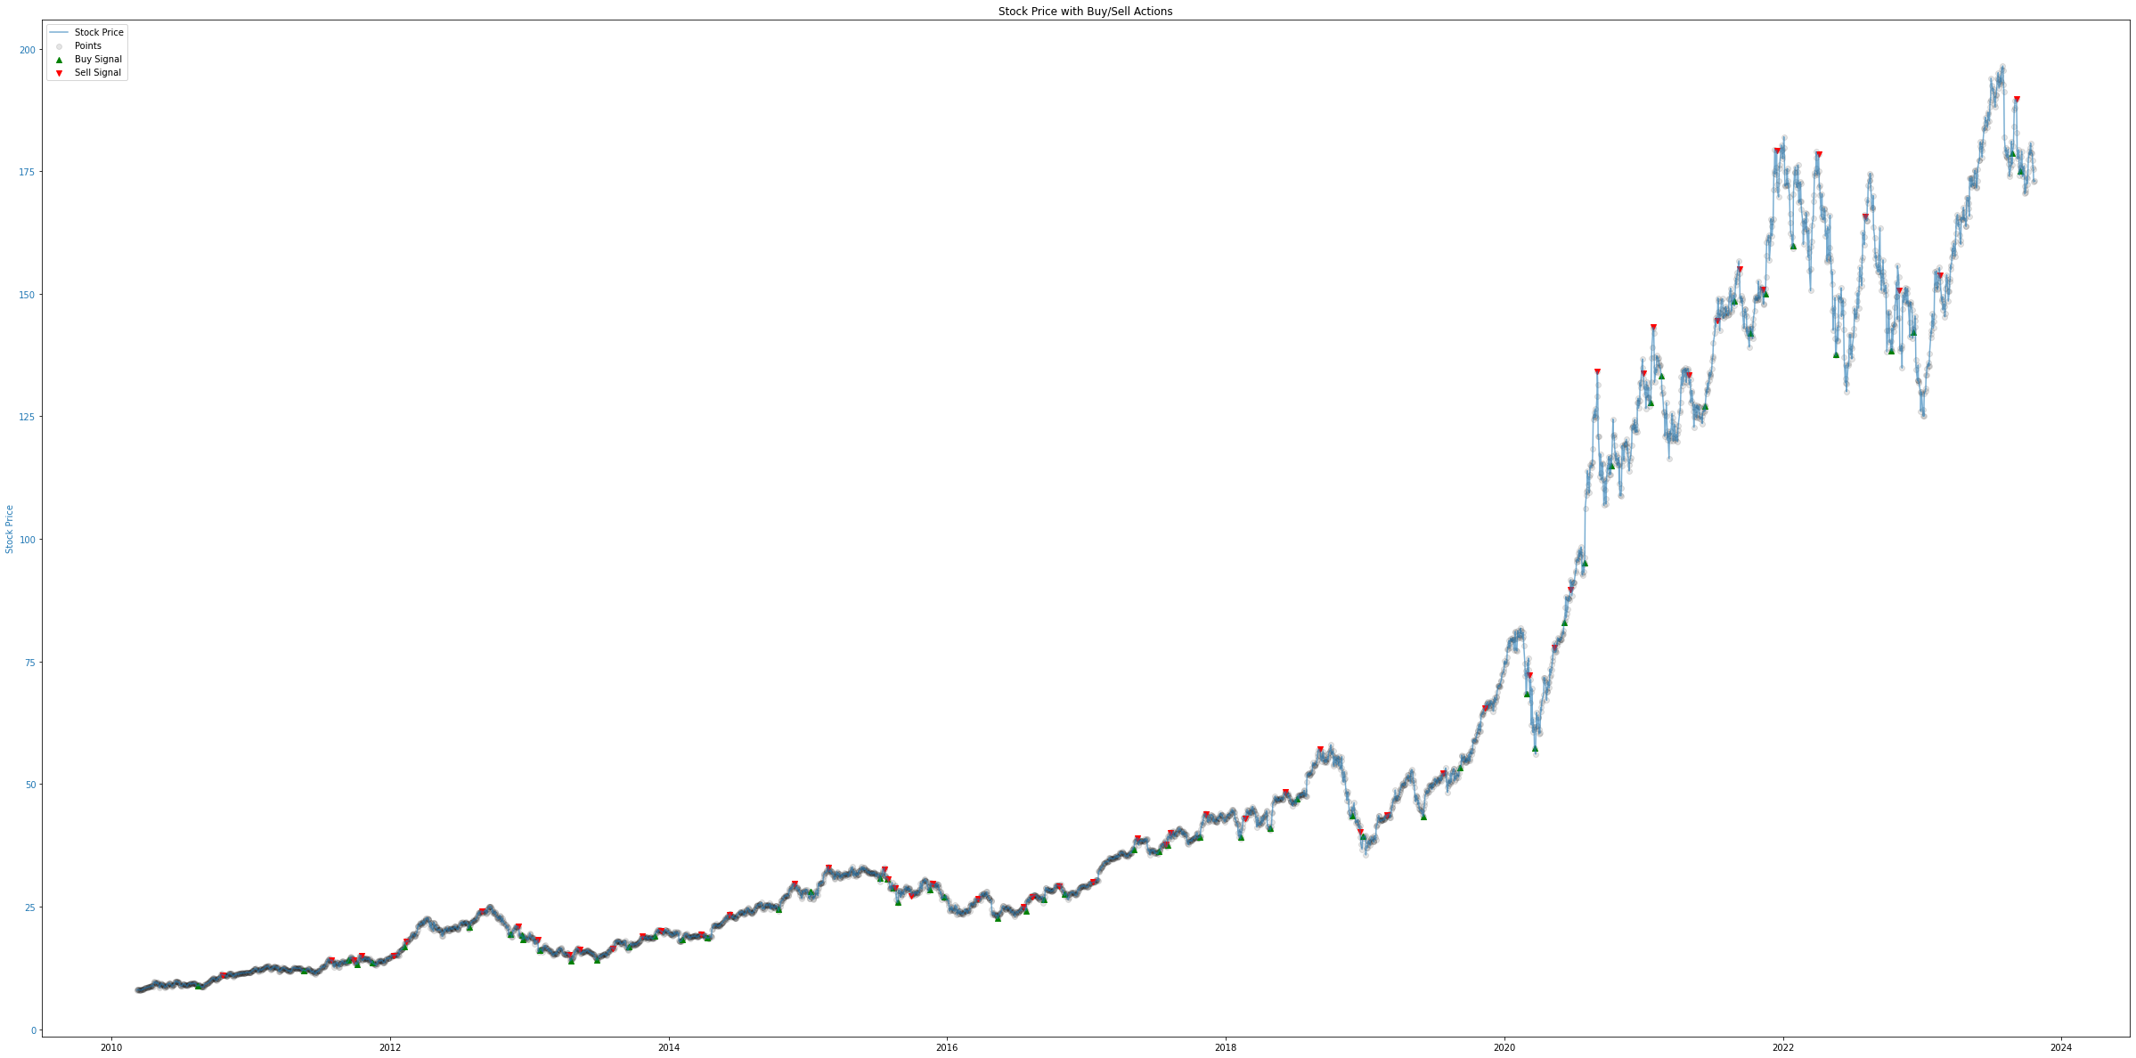

Slide 13
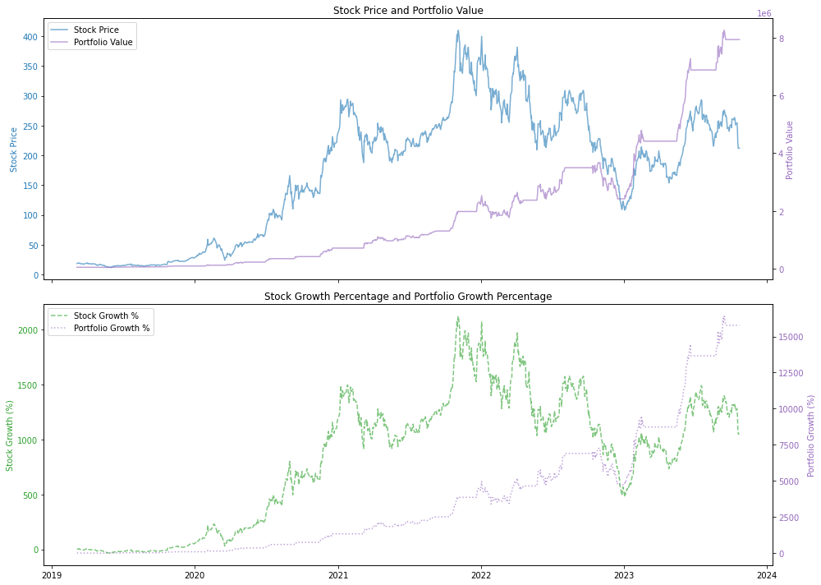
Tesla

Slide 14
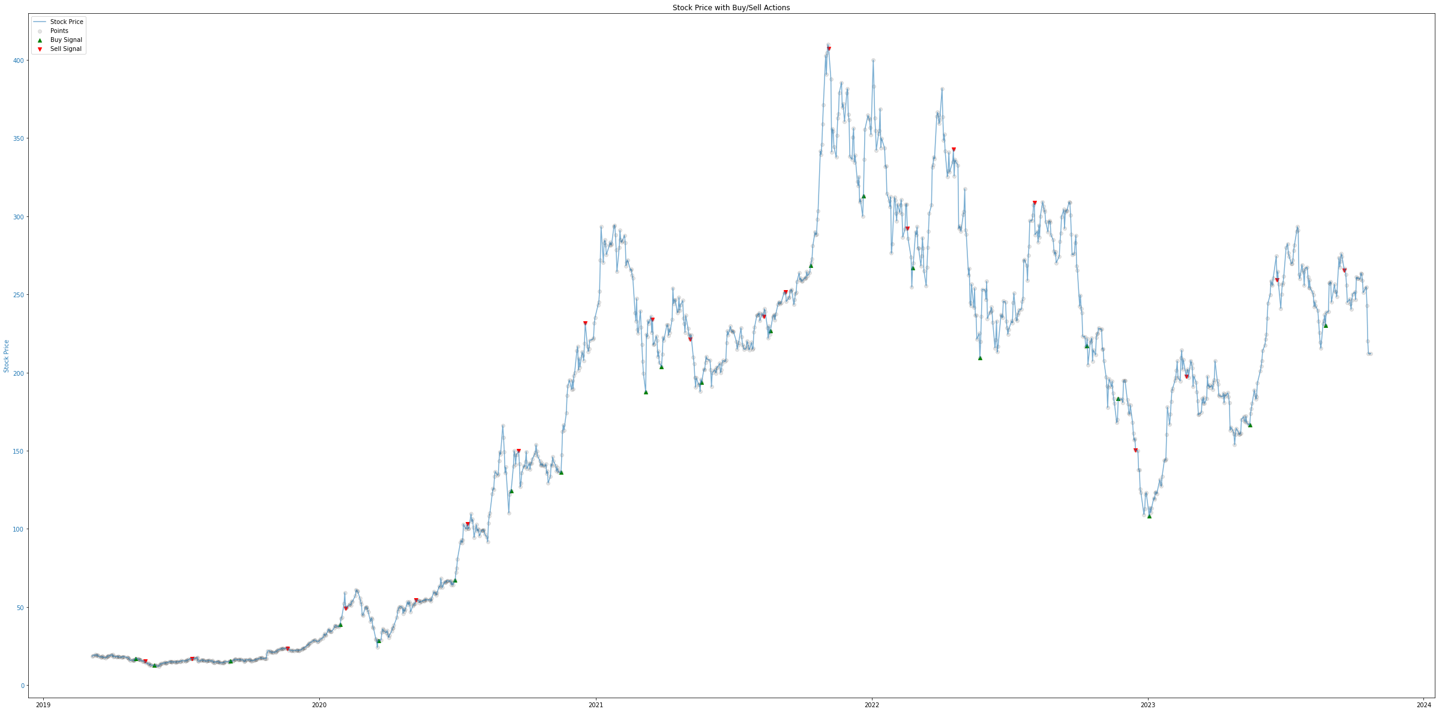

Slide 15
What we can do better?
Sentiment Analysis
Capture the sentiment from institutional traders: news, reports published by professional analyst
Stock Prediction
Capture more stocks/sectors: meme stock, health sector, retail sector, etc.
Gather more data: earning reports, unemployment rate (every Friday), Open Interest (Option), etc
Stock selection (finding alpha)
Portfolio Optimization

Slide 16

Q&A

Slide 17

Thank you!

